Slide 1
Correction of Electro Cardiogram (ECG) wander and application to the Pan & Tompkins QRS detection algorithm by determining heart rate abnormality
Made by-
S Srinibha-17BEC0926
Hrithik Sarda-17BEC0078
Soumya Ludra- 17BEC0725
Siddharth Veera-17BEC0902

Slide 2
Objective
Extraction of QRS complexes from the ECG signal using The Pan & Tompkins QRS detection algorithm.
To determine the abnormality in heart rate.
We corrected the ECG baseline using a median filter to make it horizontal in order to apply a fixed thresholding.
Improving The Pan & Tompkins QRS detection algorithm by correcting the baseline by applying a fixed thresholding instead of adaptatif thresholding (Correction of baseline wander.)

Slide 3
Introduction
The Pan & Tompkins QRS detection algorithm is based upon digital analyses of slopes, amplitude, and width. The methodology followed is that the ECG is passed through a special digital bandpass filter (low pass and high pass filter in cascade), to reduce the noise (muscle noise, 60Hz interference, base wander and T wave interference.) Then the filtered signal is passed through derivative, squaring (to make all data points positive and emphasizing on higher frequency terms) and window integration (to obtain wave-form feature information) phases. Finally, an adaptative threshold is applied in order to increase the detection sensitivity (two thresholds are adjusted, the first one identifies peaks of the signal and the second is used when no peak has been detected by the first one in a certain time interval. In this case, the algorithm has to search back in time for a lost peak by using a threshold lower than the first one.)

Slide 4
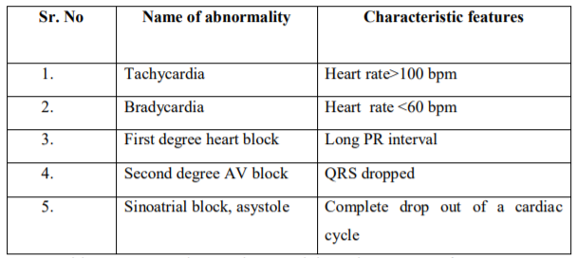
The heart rate is calculated by using the Pan & Tompkins QRS detection algorithm hence determining any abnormality in the heart rate.
Correction of ECG Baseline wander- To remove baseline drifts without corrupting the R-waves, a non-linear high pass filter is used. Then the result is subtracted from the original signal creating a high pass filtered version of ECG signal with a constant zero-volt level. The complexity order is reduced compared to the original method.

Slide 5
Literature Survey
S.No | Title of paper | Author | Year of publication | Description | GAP
1 | New aspects in ECG Signal Processing Using adaptive Filters | Ion Tudosa, Narcis Iulian Adochiei, Razvan Ciobotariu | 2011 | The concept of adaptive filtering for ECG signal requires knowledge of the reference signal, usually the 50Hz from mains electricity. The reference signal is not always necessary to be the 50Hz from the power grid; there are cases where we need a reference like electronic noise. This noise can be superimposed on the ECG signal for various reasons, which include the sources of energy (small amplitude oscillations). The implementation of adaptive ECG signal processing, requires a compliance with technical requirements. The adaptive filter produces an output signal, which is an estimate of the noise component that is present in the primary signal, and after subtraction from primary signal, it obtains a filtered signal. Application of embedded systems with digital signal processors like DSP type shows a great advantage in ECG signal processing. By applying FFT on the filtered signal the harmonics components disappear from the signal spectrum, and we get our filtered ECG output. | The implication of this research may be helpful for bioengineers and researchers in area of bio-signals filtering. Nowadays, a problem still remains for engineers and scientific researchers, the practical implementations of Adaptive ECG Filtering Systems. The paper presents an original work related to recovering ECG signal from unwanted noises and interferences.

Slide 6
Literature Survey
S.No | Title of paper | Author | Year of publication | Description | GAP
2 | Correction of ECG baseline wander Application to the Pan & Tompkins QRS detection algorithm | Nehla Debbabi, Sadok El Asmi, Hichem Arfa | 2010 | The paper is divided into 2 major portions: Section 1: The Pan & Tompkins QRS detection algorithm , is the most widely used and the often cited algorithm for the extraction of QRS complexes from the ECG signal. The algorithm is based on the application of several filters and an adaptatif thresholding. This adaptatif threshold is due to baseline deviation, for that it must be adapted to every cardiac cycle. Section 2: To improve the performance of the Pan & Tompkins QRS detection algorithm and to reduce its processing time they corrected the baseline in order to apply a fix thresholding instead of the adaptatif thresholding. In order to remove the baseline drifts without any corruption of the R-waves, we apply a non linear high pass filter on the ECG signal [5]. Which produces a smoothed version of the signal where only the patterns remain. Then the result of this filter is subtracted from the original signal, creating a high pass filtered version of ECG signal with a constant zero-volt level. | ----

Slide 7
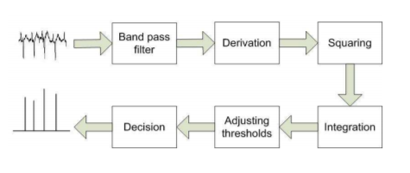
Methodology
Pan & Tompkins QRS detection Algorithm
Correction of ECG Baseline wonder
Non-linear high pass filter
Result is subtracted from the original signal

Slide 8
Future work left
This method has a complexity of order O(n) as the number of addition and multiplication. The order of complexity can further be improved and therefore optimized.

Slide 9
References
https://ieeexplore.ieee.org/document/5952180
https://ieeexplore.ieee.org/document/5654714

